Slide 1
Circuit Breakers
Program
Notes:
Acknowledgement of country
Where applicable and after introducing yourself and your presentation you should start with an Acknowledgment of country, use the script below:
“I’d like to start by acknowledging the Traditional Owners of the land on which we meet today. I pay my respects to their elders, both past and present.”

Slide 2
Contents
Circuit Breakers activity by activity
  Activity One
  Activity Two
  Activity Three
  Activity Four
  Activity Five
  Activity Six
  Activity Seven
  Activity Eight
  Activity Nine
  Acitivity Ten

Slide 3

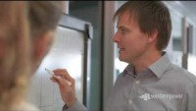

Activity One
Mini computer
Talk about Western Power, engineering and other STEM jobs. Introduce Circuit Breakers program
Discuss - What is a computer?
Explore the micro:bit? – discover it’s parts and power it up.

Slide 4
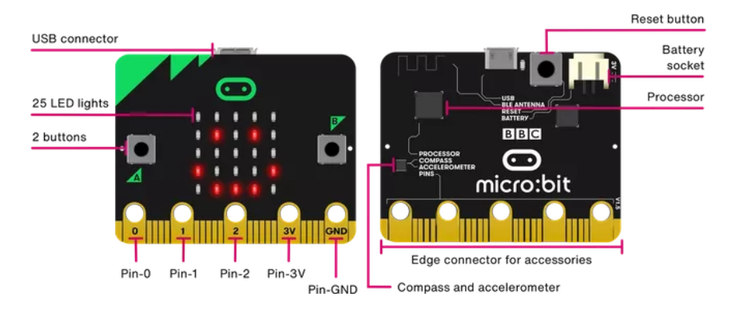
Micro:bit bits

Slide 5
Activity One
Mini computer
Key learning
Features of a computer (inputs and outputs)
Know way around the micro:bit (inputs and outputs)
About STEM working
Questions
What would you like to do with a micro:bit?
What do you think Western Power might use computers or mini-computers for on the network?

Slide 6
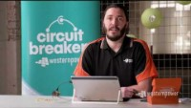
Activity Two
Code & Download
Make link between computers and coding
Create a simple code in MakeCode website, download it to micro:bit

Slide 7
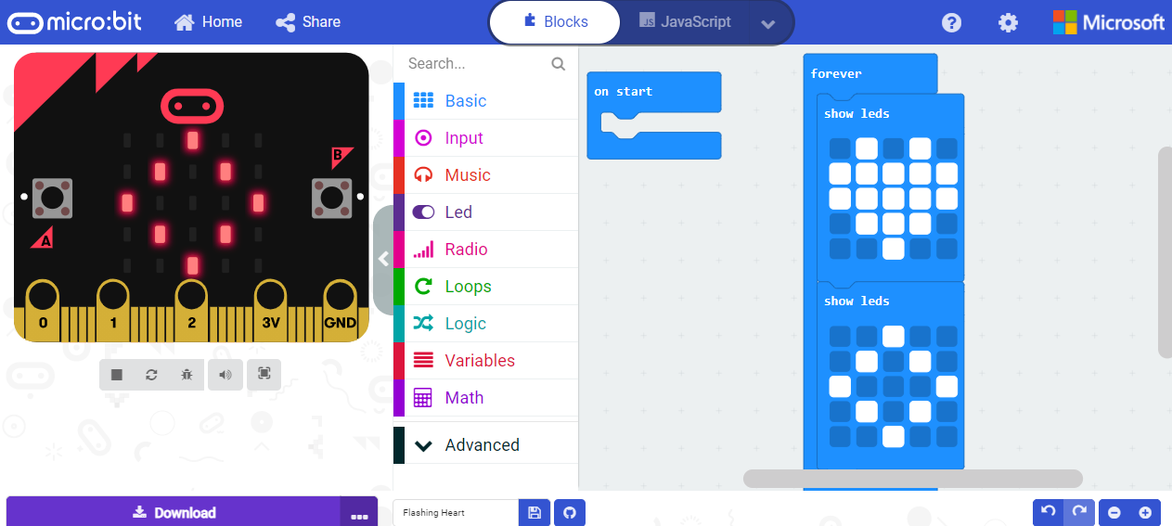
Coding micro:bit

Slide 8
Activity Two
Code & download
Key Learning
Computers are in many things
Computers follow stepped out instructions call code.
Using MakeCode for Micro:bit
Questions
Do you think the digital way of making or playing is better or worse than doing it with you hands?
Who might benefit from being able to play the digital way?

Slide 9

Activity Three
Circuit control
Explain how electricity is made and bought to our homes
Make a simple circuit with batteries and LED
Make a simple circuit with micro:bit

Slide 10
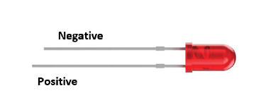
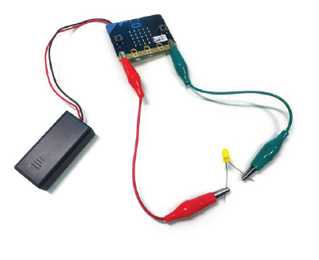
Making electrical circuits

Slide 11
Activity Three
Circuit control
Key Learning
Electricity travels in circuits
Breaking and making a circuit using a switch
How to put micro:bit into circuit (as controller and power source.)
Questions
What if we had lots of LEDs and we wanted to turn them on one at a time – how would you do that?
How could a micro:bit be used as a controller

Slide 12

Activity Four
Fully charged up
Learn about solar power & large batteries
Extend circuit by putting LEDs in parallel
Measure electricity using micro:bit
Control LEDs with micro:bit

Slide 13
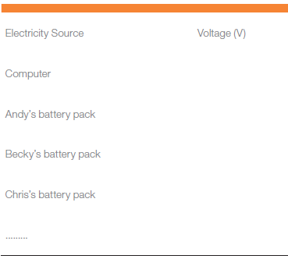
Measuring electricity chart

Slide 14
Activity Four
Fully charged up
Key learning
Measuring voltage of electricity
Graphing a collection of data for comparison
About solar electricity (batteries, SPS and microgrid)
Questions
What things/events can interrupt the electricity supply?
How can you ensure your grid has enough power all of the time?

Slide 15

Activity Five
Reaction time
Discover what are electrical conductors
Making game using conductivity (and reaction time) with micro:bit as controller

Slide 16
Reaction time game connections

Slide 17
Activity Five
Reaction time
Key Learning
Conductors carry electricity easily
People are conductors of electricity and can form part of a circuit
Micro:bits can control a response
Questions
What ways could you improve you reaction timer game?
What does this suggest to you about how the micro:bit can work in your model future grid?

Slide 18
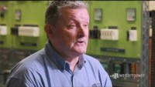
Activity Six
Power community
Discuss - how, where and when electricity is dangerous. Staying safe
Make alarm using micro:bit system

Slide 19
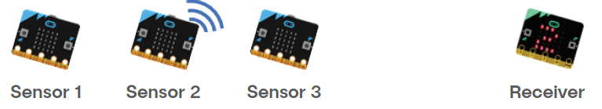
Sensors and receivers

Slide 20
Activity Six
Power community
Key Learning
Western Power assets
Safety around electricity
Coding an alarm
Questions
What do you do if in a vehicle that crashes into a power pole? And why?
What ways could someone be alerted to a fault?

Slide 21
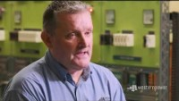
Activity Seven
Emergency warning sensors
Discuss - what are sensors and what are they used for
Code Micro:bit to read sensors

Slide 22
Reading the sensors

Slide 23
Activity Seven
Emergency warning sensors
Key learning
Examples of sensors and what they do
Programming a sensor
Western Power detects faults in the system and uses alarms
Question
What sensors will be helpful in your grid of the future?

Slide 24

Activity Eight
Electric light orchestra
Coding for controlling LEDs
Use micro:bit to make sound (needs headphones)

Slide 25
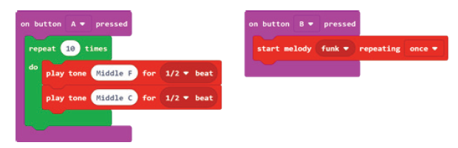
Adding sound

Slide 26
Activity Eight
Electric light orchestra
Key learning
Electricity is silent
Coding multiple lights and light sequences
Getting micro:bit to produce sound
Question
What would you like program the micro:bit to do?

Slide 27

Activity Nine
Design & engineering
Discuss future community needs
Look at Western power solutions for future grid
Future community designing
Identifying 3D shapes in building and engineering, make 3D shapes

Slide 28
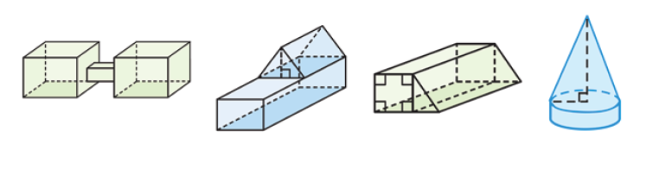
3D shapes for buildings

Slide 29
Activity Nine
Design & Engineering
Key learning
Design needs for future community
Using 3D shapes, making 3D shapes from 2D nets
Western Power future community projects
Questions
What do you think is essential for your community that you are designing for?
What would you like your community to have?

Slide 30


Activity Ten
The network of the future
Design and code micro:bit for model
Build micro:bit into model

Slide 31
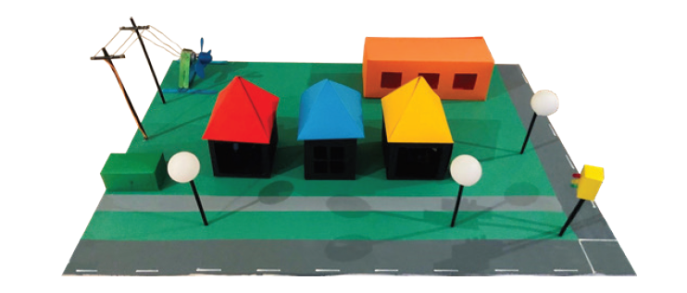
Build community model with micro:bits

Slide 32
Activity Ten
The network of the future
Key learning
Design process
Building skills
Teamwork
Questions
What coding didn’t work the way you expected and what did you learn from that?
What did you not get to do that you would have liked to have done?

