Slide 1
Circuit Breakers 2021
Bull Creek Primary School

Slide 2
Our School
We have around 450 students from PP to year 6
A growing Digital Technology focus
We are in the Southern suburbs of Perth, Bull Creek
Our Circuit Breaker team consisted of yr6’s across two different classes.

Slide 3
What we learnt about Western Power
Western Power safely and sustainably brings power to our homes and businesses. From Perth to Albany, Kalbarri to Kalgoorlie and in between! Whether it’s in the field, office or control centre. Western Power is Western Australian through and through.

Slide 4
What is STEM?
STEM is about solving problems and uses Science, Technology, Engineering and Maths to do so.
You don’t have to be an expert in all these things but be able to harness the essential transferable skills behind them.
Teamwork and adaptability are really important skills in STEM activities.

Slide 5
Engineering
Engineering is about problem solving. They look at how things work, design, improve, reflect, build, innovate, listen and work with others.
Within Western Power there are many different types of Engineers that have very different roles in supporting the safe and reliable transportation of Power.
We had two Engineers who came to teach us about what they do and support us on our Circuit Breakers journey. They were both different Engineers. Gina was an Operations Engineer and Cherry was a SCADA Engineer.

Slide 6
Micro:bit
Micro:bits are mini computers that let you get creative with digital technology. An embedded controller is the name for a small computer. These are found in fridges, cars, street lights and even the microchip in your dog.
Microbits can be coded using a sequence of instructions written in a special language to play games and for real life implications like scrolling suburb names at a train station.

Slide 7
Our Micro town:
Our town of the future is called FutureCreek
We have a sheep farm, lake, greenhouse, retirement village run by solar energy, community battery where the extra power is fed back to, an arena, café, train line, tepee eco village, park, summer camp and trees.
It was inspired by our imagination and our perfect town. We had a strong sustainable focus. This was because we learnt how these types of power work and how good they are for the environment.

Slide 8
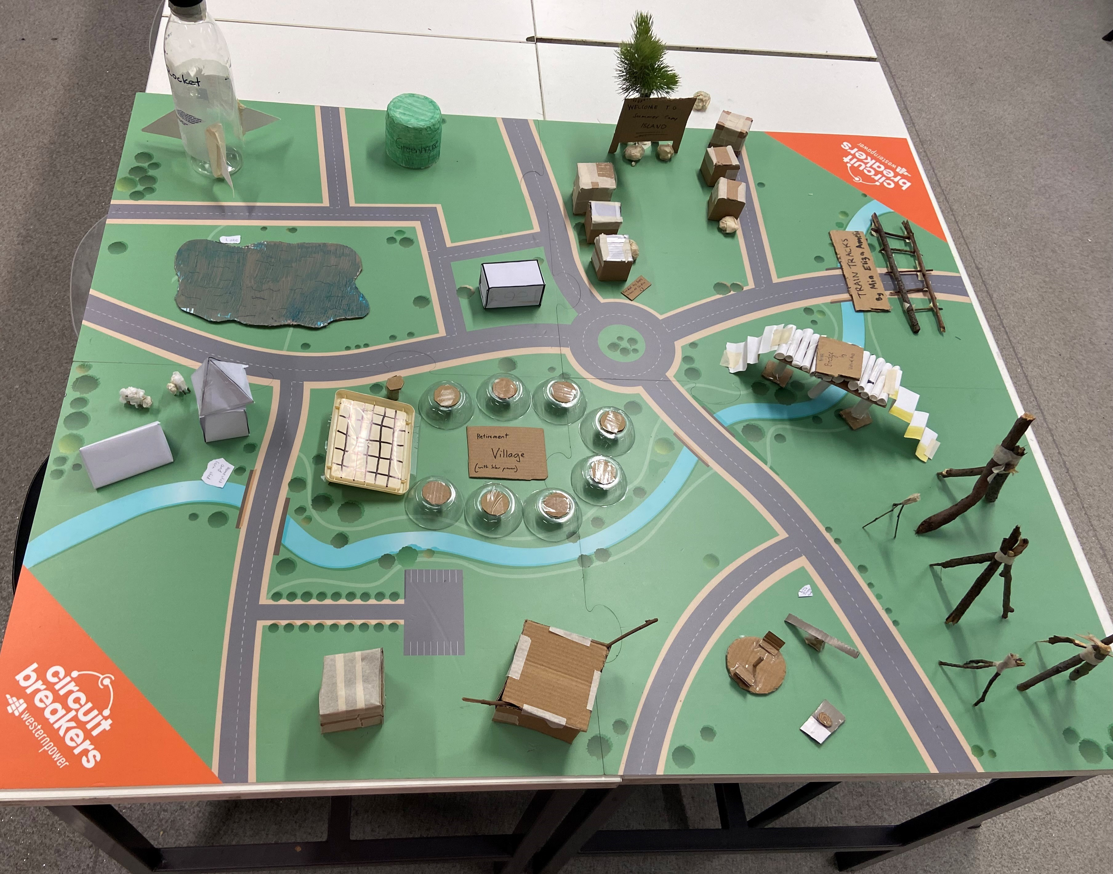
Rocket coded flashing lights
Fairy lights that turn on at night at the Summer Camp
Lights on poles near train tracks to show
a train is coming.
A sign with name of town flashing
Lights that turn on at night on the Bridge
Lights and water reticulation
At the farm.
Lights, sensors and alarms
At the Retirement Village
Speakers, lights and screens for the Arena

Slide 9
Our Reflection
The groups reflected on our microtown and decided we perhaps missed some important infrastructure like a school, hospital, fire station and Police station. There were lots of other ideas too like wind turbines and hydro power for more sustainable power. The ideas were endless. ☺
Thank you Western Power for the grant to do this program and access to the awesome Micro:Bits. We certainly will look at the world around us in a different way now and who knows some of the students may even go on to become Engineers.
The End

